Slide 1


Subject Code: SIT-1205
Subject Name: Object Oriented Analysis and Design
Faculty Name: Dr.R.Jeberson Retna Raj
Dr.R.M Gomathi

Slide 2
UNIT 2 OBJECT ORIENTED METHODOLOGIES
Rumbaugh et al.’s Object Modeling Technique - Booch Methodology - Jacobson et al. Methodologies - Patterns - Framework - Unified approach - Unified Modeling Language:Static and Model - UML Diagrams - UML Class Diagram - UML Usecase Diagram - UML Dynamic Modeling - UML Extensibility - UML Metamodel.

Slide 3
Rumbaugh’s Object Modeling Technique
Well suited for describing the object model or static structure of the program.
A method for analysis, design and implementation by an object oriented technique.
Fast and intuitive approach for identifying and modeling all objects making up a system.-
Rumbaugh’s Object Modeling Technique (OMT)- is fast
Identifying and modeling all the objects to making up the system.
Identifying class, attribute, method, inheritance and association can be expressed easily.
Dynamic behavior of objects can be described using the OMT dynamic model.-Detailed specification of state transitions and their-descriptions within a system

Slide 4
Rumbaugh’s Object Modeling Technique
Process description and consumer producer relationship expressed using OMT functional model.

Slide 5
Rumbaugh’s Object Modeling Technique
Four phases of OMT (can be performed iteratively)
Analysis: Results are objects, dynamic and functional models
System Design: Results are structure of basic architecture of the system.
Object Design: Produces a design document, consists of detailed objects static, dynamic, functional model of objects.
Implementation: Produces reusable, extendible and robust code.

Slide 6
Three different parts of OMT modeling
An object model - object model & data dictionary
A dynamic model - state diagrams & event flow diagrams
A functional model - data flow & constraints

Slide 7
Object Model
Describes structure of objects in a system.
Identity, relationships to other objects, attributes and operations.
Object diagram

Slide 8
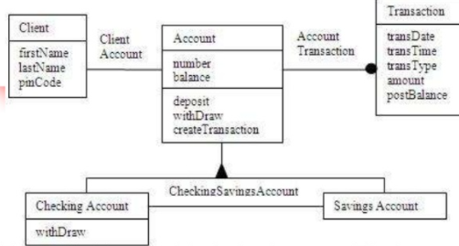
Object Model
Classes interconnected by association rule
Each class represents a set of individual objects
Association line establishes relationship among the classes

Slide 9
Object Model
The OMT object model of a bank system.
The boxes represent classes and the filled triangle represents specialization.
Association between Account and Transaction is one to many;since one account can have many transactions, the filled circle presents many (zero or more).
The relationship between Client and Account classes is one to one:
A client can have only one account and account can belong to only one person (in this model joint accounts are not allowed).

Slide 10
Object Model
Object Diagram
Classes interconnected by association lines
Classes- a set of individual objects
Association lines- relationship among classes (i.e., objects of one class to objects of another class)

Slide 11
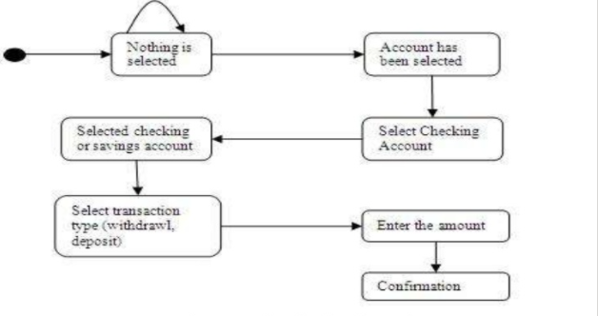
OMT Dynamic Model
OMT Dynamic Model
OMT state transition diagram is a network of States, transitions, events and action
The next state is depends on the current state as well as the events.

Slide 12
OMT Dynamic Model
State transition diagram for the bank application user interface.
The round boxes represent states and the arrows represent transitions

Slide 13
OMT Functional Model
DFD- (Data Flow Diagram)-Shows flow of data between different processes in a business.
Simple and intuitive method for describing business processes without focusing on the details of computer systems.

Slide 14
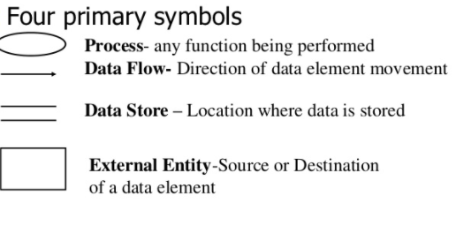
DFD- (Data Flow Diagram)

Slide 15
Data Flow Diagram
Four primary symbols Process
any function being performed Data Flow
Direction of data element movement Data Store
Location where data is stored External Entity
Source or Destination of a data element

Slide 16
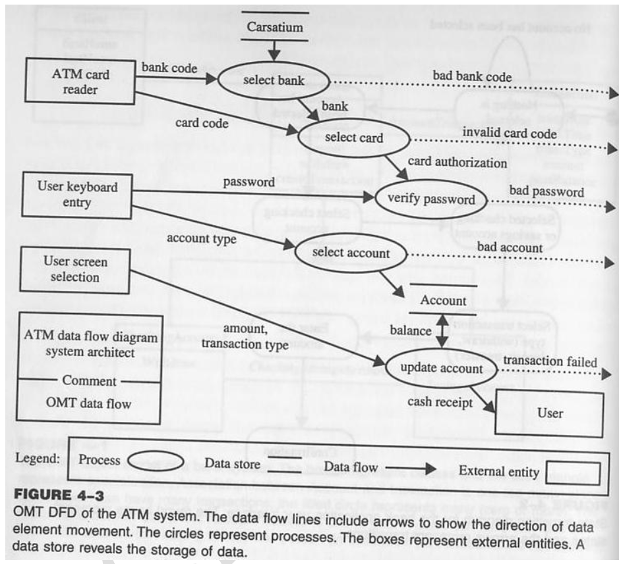
OMT Data Flow Diagram of the ATM system

Slide 17
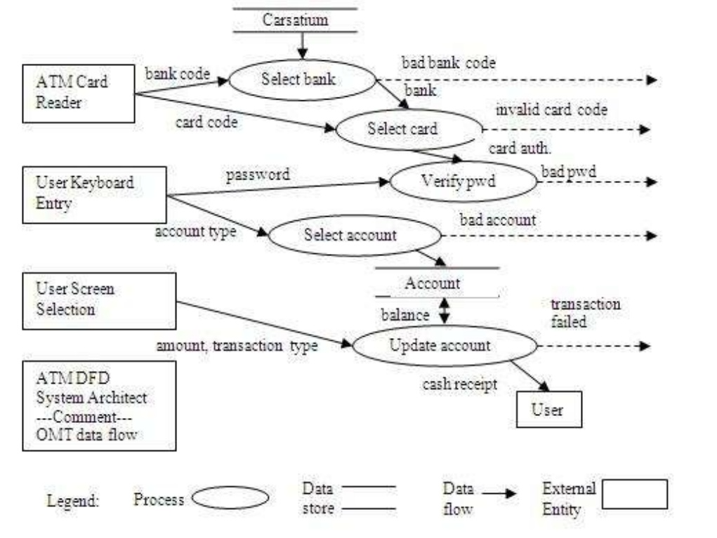

Slide 18

The Booch Methodology
In software engineering the Booch method, that is published in 1991 by Grady Booch, is a widely used method in object-oriented analysis and design.
Widely used OO method
It covers the analysis- and design phases of an object-oriented system.
The method defines different models to describe a system and it supports the iterative and incremental development of systems.
Uses the object paradigm
Criticized for his large set of symbols

Slide 19
The Booch Methodology
Analysis & design method using object oriented paradigm
Start with class & object diagrams in analysis phase
Diagrams refined in various steps
Add design symbols when ready to generate code
Object-oriented code documented

Slide 20
Diagrams of Booch method
Class diagrams- describe roles and responsibilities of objects
Object diagrams describe the desired behavior of the system in terms of scenarios
State transition diagrams state of a class based on a stimulus
Module diagrams to map out where each class & object should be declared
Process diagrams to determine to which processor to allocate a process
Interaction diagrams describes behavior of the system in terms of scenarios

Slide 21
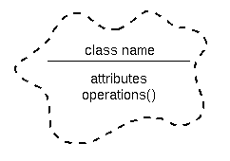
Figure 1. A class diagram notation.

Slide 22
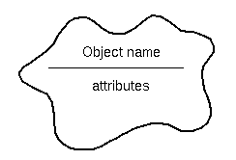
Figure 2. A object diagram notation

Slide 23
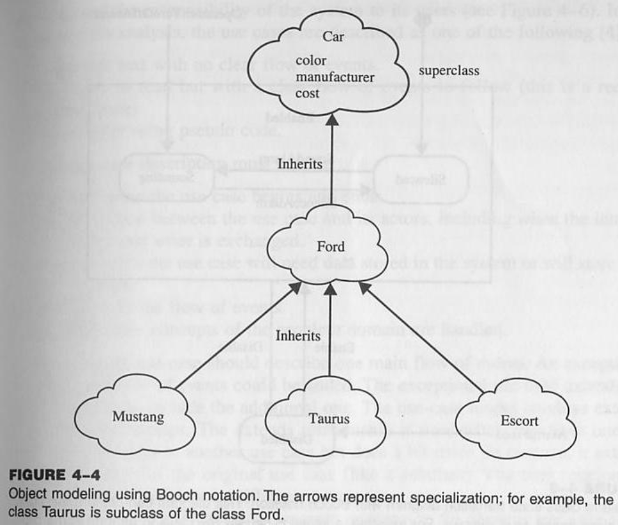
Booch Class Diagram

Slide 24
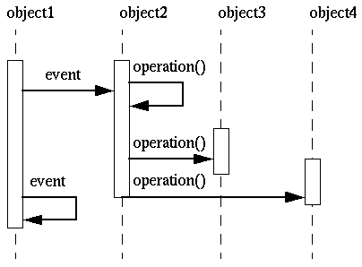
Figure 3. An interaction diagram.
The dynamic nature of an application can be illustrated by state transition and interaction diagrams.

Slide 25
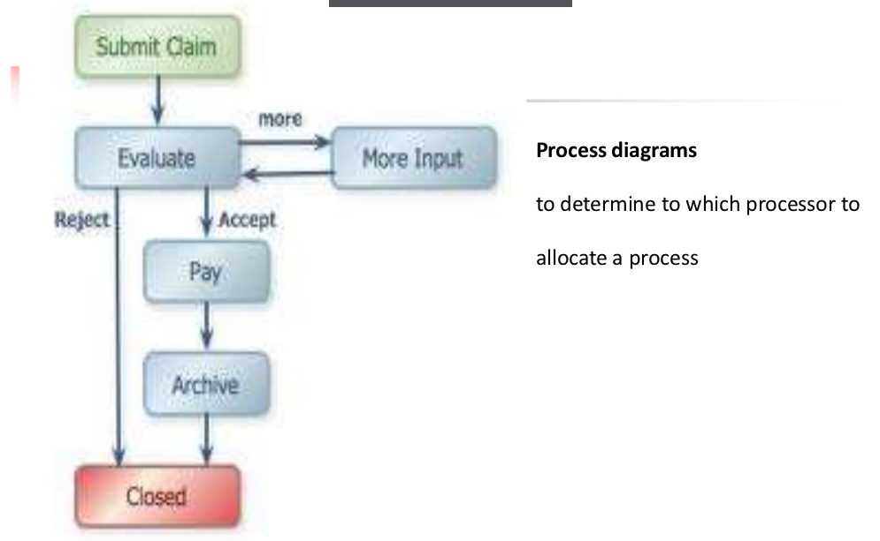
Process Diagram

Slide 26
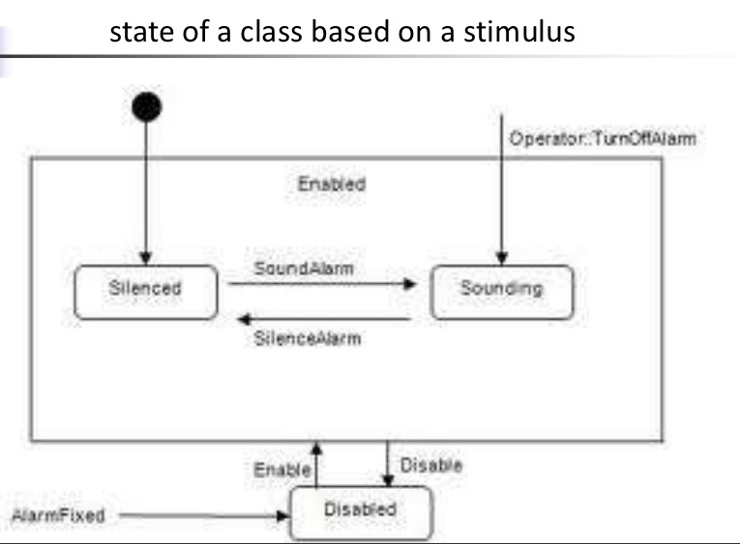
State Transition Diagram

Slide 27
Booch method
Booch method prescribes:
Macro Development Process
Micro Development Process
Macro Development Process
Controlling framework for the micro process.
Primary concern-technical management of the system.

Slide 28
Macro development process
Steps for macro development process
1. Conceptualization :
establish core requirements of the system (goal, develop a prototype)
2. Analysis & Development of the model
Use class diagram to describes role and responsibilities of objects.
Use object diagram to describe the desired behaviour of the system.
3. Design or create the system architecture
Use class diagram → classes and things related each other
Use object diagram → how object collaborate
Use process diagram → to determine which processor to allocate process

Slide 29
Macro development process
4. Evolution or implementation
Refine the system through many iterations.
5. Maintenance
Make localized changes the system to add new requirements and eliminate bugs

Slide 30
Micro Development Process
Micro Development Process
Each macro process has its own micro development process steps
Micro process is a small description of the day-to-day activities by a single or small group of s/w developers.
Steps:-
Identify classes & objects
Identify class & objects semantics
Identify class & object relationship
Identify class & objects interface and implementation

Slide 31
Jacobson Methodologies
Covers entire life cycle and stress traceability both forward and backward
Heart → use case concept
Use Cases.
Scenarios for understanding system requirements.
Interaction between user and system
Capture the goal of user and responsibility of the system with its users
In requirement analysis, the use cases are described
Non formal text with no clear flow of events
Text, easy to read with clear flow of events (Recommended)
Formal psuedo code

Slide 32
Jacobson Methodologies
The use case description must contain
How and when the use case begins and ends.
The Interaction between the use case and its actors, including when the interaction occurs and what is exchanged.
How and when the use case will need data stored in the system.
Exception to the flow of events
How and when concepts of the problem domain are handled.

Slide 33
Jacobson Methodologies
Use case – other features
Every single use case describe one main flow of event
Use case model employs extends and uses relationship
Use case could be viewed as abstract or concrete.
Abstract use case → not complete and has no actors

Slide 34
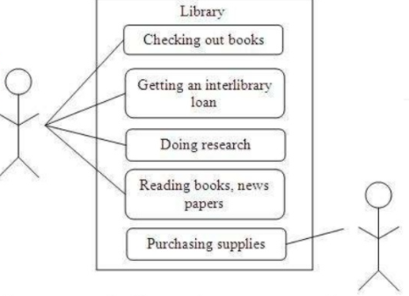
Some uses of a library. As you can see, these are external views of the library system from the actor such as a member. The simpler the use case, the more effective it will be. It is unwise to capture all of the details right at the start; you can do that later.

Slide 35
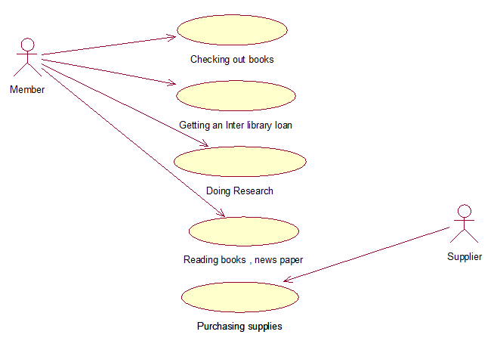

Slide 36
Jacobson Methodologies
Object Oriented Software Engineering (OOSE) : Objectory.
Is a OO dev. with the specific aim to fit the development of large , real-time systems
Development process also called Use-Case Driven Development
Object Oriented Business Engineering (OOBE).
Is object modeling at the enterprise level
Use Cases.
Understanding system requirements
Interaction between Users and Systems

Slide 37
OOSE : Object Oriented Software Engineering
OOSE : Object Oriented Software Engineering.
Objectory is built around several different models:
The use-case model defines the outside (actors) and inside (use case) of the systems behavior.
Domain object model. The objects of the “real” world are mapped into the domain object model.
Analysis object model. The analysis object model presents how the source code (implementation) should be carried out and written.
Implementation model. The implementation model represents the implementation of the system.
Test model. The test model constitutes the test plans, specifications, and reports.

Slide 38
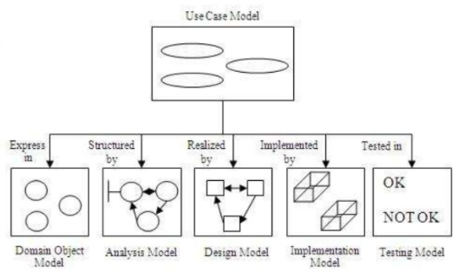
The use-case model is considered in every model and phase.

Slide 39
OOBE(Object Oriented Business Engineering)
OOBE(Object Oriented Business Engineering)
Object Oriented Business Engineering
OOBE is object modeling at the enterprise level.
Use case is a central vehicle provides traceability
Analysis phase
Iterative, but the requirements and analysis model should be stable.
Prototyping with a tool is useful for specifying user interfaces
Design and Implementation phase
Identify implementation environment
DBMS, Distribution of process
Available component libraries
Graphical UI tools

Slide 40
OOBE(Object Oriented Business Engineering)
Testing phase
E.g. Unit testing, integration and system testing

Slide 41
Summary – Jacobson Methodology
Object-oriented business engineering (OOBE)
Object-oriented software engineering (OOSE)
Object Factory for Software Development (Objectory)
Cover entire life cycle
Stress traceability between phases – backward & forward
Enables reuse of analysis & design work
Use-case concepts used

Slide 42
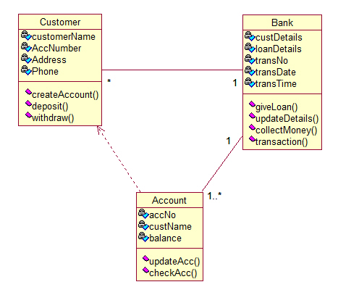
Class diagrams

Slide 43
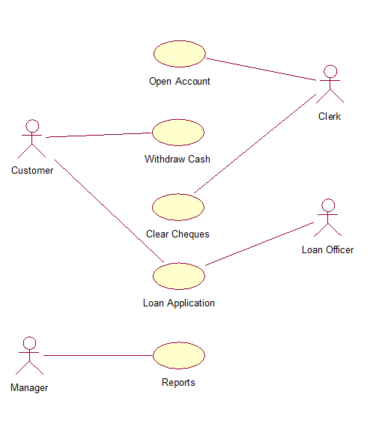
Use case Diagram

Slide 44
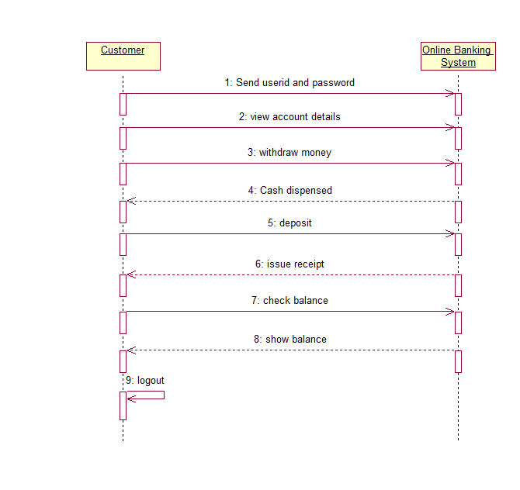

Slide 45
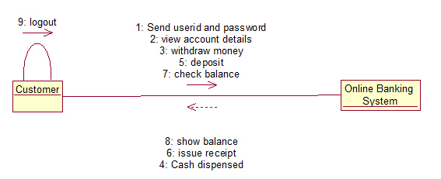

Slide 46
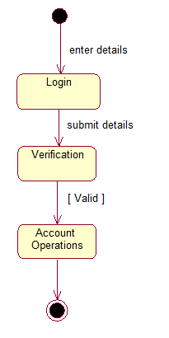
Statechart Diagram

Slide 47
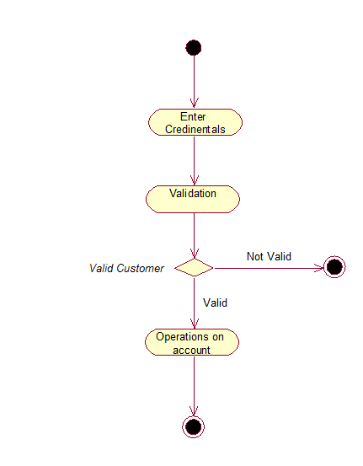
Activity Diagram

Slide 48
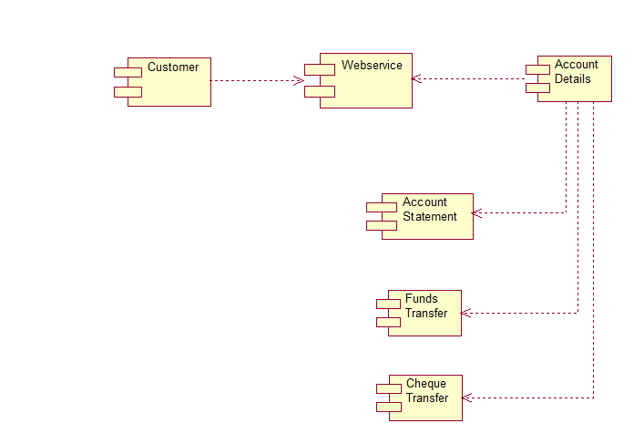
Component Diagram

Slide 49
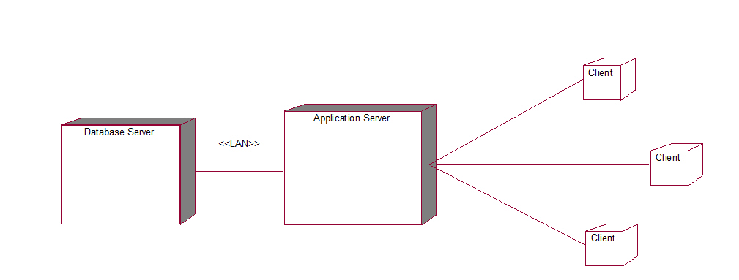
Deployment Diagram

